Slide 1


MODULE 1:
HOW TO UPLOAD VIDEO IN YOUTUBE
VIA COMPUTER?

Slide 2

Introduction
How to upload video in YouTube using Computer?

Slide 3
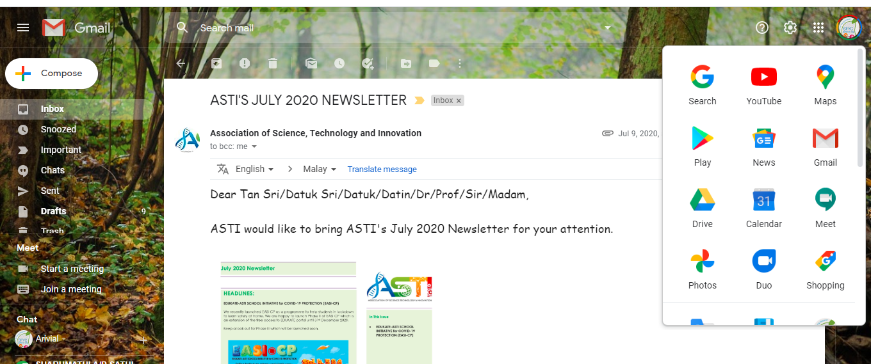

Using YouTube in Computer
STEP 1
Open Gmail account.
You can use anyone’s Google Account to upload the Video.
Tap Google apps. It's at the top-right corner of the screen and then click You Tube icon.
STEP 2

Slide 4
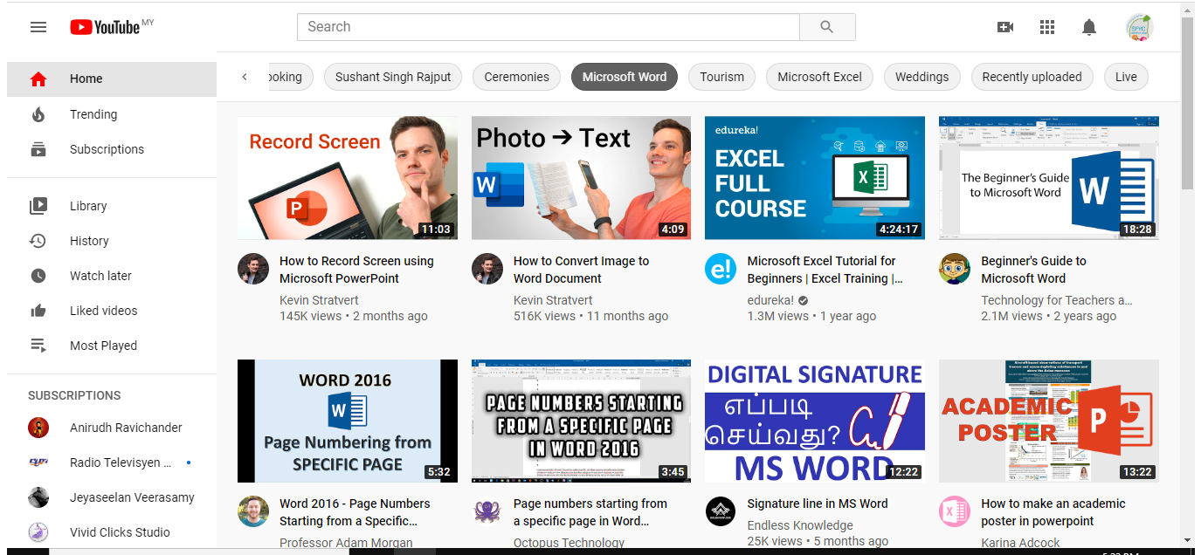
Using YouTube in Computer
STEP 3
Tap the Video Icon
It's on the right side of the bar that runs along the top of the screen.
Then tap Upload Video.

Slide 5
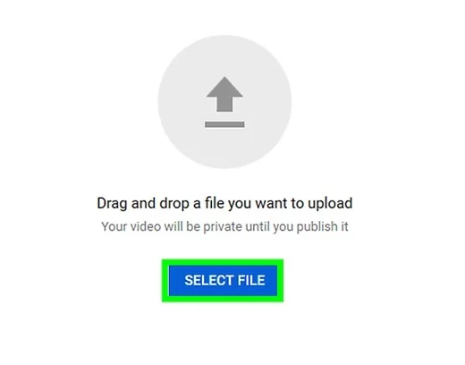
Using YouTube in Computer
STEP 4
Select files.
Select the video from your laptop. Make sure the video saved as School Name.

Slide 6
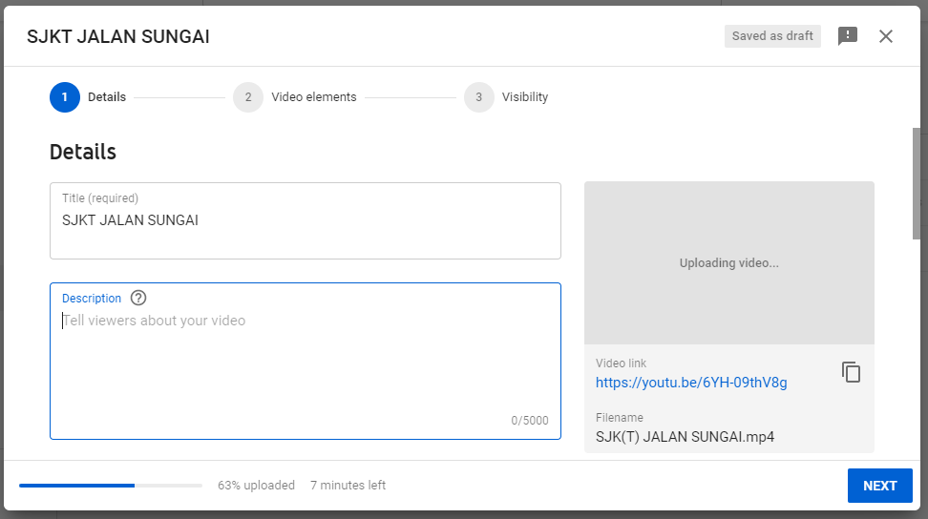
Using YouTube in Computer
STEP 5
Type the title.
Title must be your ZLSF2022_school name.
Enter a description (optional).
Info in the description will appear below your video while viewing. You can use this space to add some unique information about the video, the creator, or project.

Slide 7
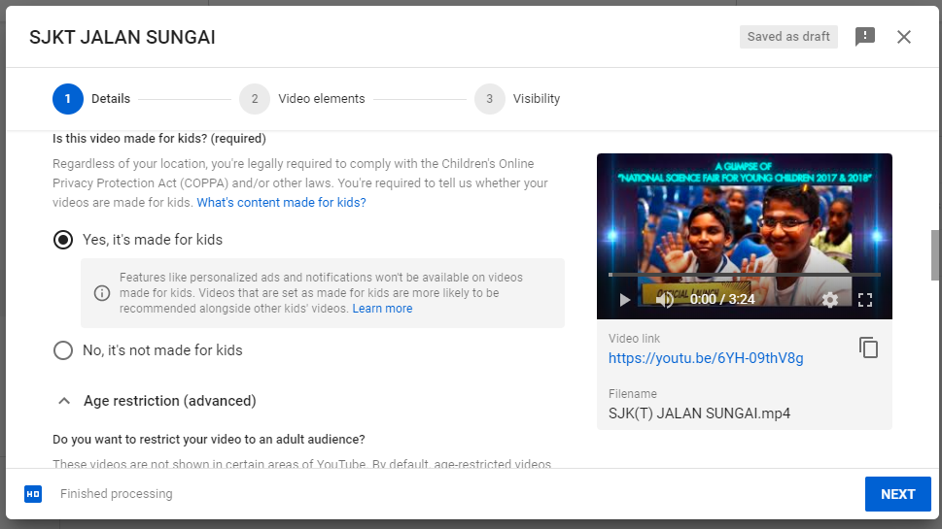
Using YouTube in Computer
STEP 6
Tap Yes, it’s made for kids and click next.

Slide 8
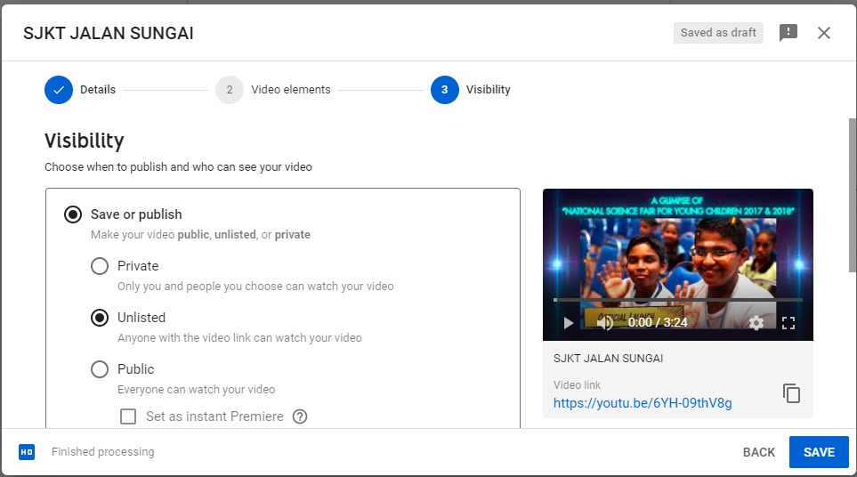
Using YouTube in Computer
STEP 7
Choose Save or Publish
Please select ‘Unlisted’ option:
This makes your video unsearchable by others. So that no one can copy your concept.

Slide 9
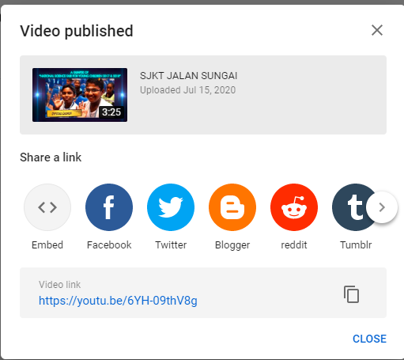
Using YouTube in Computer
STEP 8
Copy the link.
The video is now published in your You Tube Channel. You can copy the link.

Slide 10
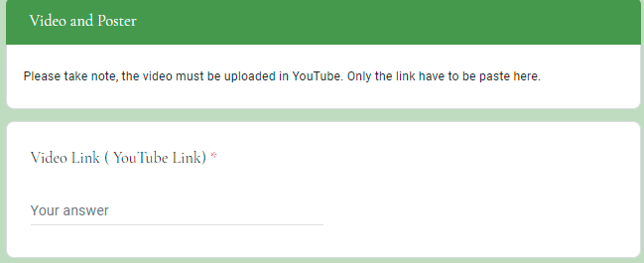
Using YouTube in Computer
STEP 9
Paste Link in Google Form.
Once done copying the link, participant can paste the video link in the google form. Please don’t edit the link. Paste as YouTube generate.

Slide 11


Slide 12

Produced By

